Slide 1

RDD (Resilient Distributed Datasets)

Slide 2
Agenda
In this session you are going to learn about
RDD and Partitions
RDD Transformation -
map,flatMap,filter,mapPartitions,mapPartitionsWithIndex,sample,union,intersection,distinct,groupBy
keyBy,Zip,zipwithIndex,Colease,Repartition,sortBy
RDD Action –
reduce(func),first,takeOrdered,take,count,collect,collectasMap,saveAsTextFile,foreachPartition,Foreach
Max,Min,Sum,Mean,Variance,stdev

Slide 3

What is RDD ?
RDD is a logical reference of a dataset which is partitioned across many server machines in the cluster. RDDs are Immutable and are self recovered in case of failure.
At the core of Spark is the notion of a Resilient Distributed Dataset(RDD), which is an immutable collection of objects that is partitioned and distributed across multiple physical nodes of a YARN cluster and that can be operated in parallel.

Slide 4
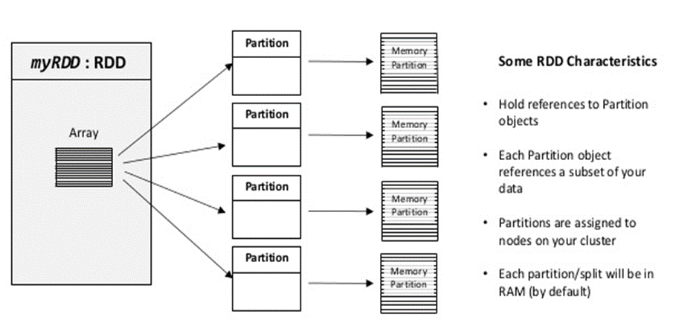
What is RDD ? (continue …)

Slide 5
How to create RDD ?
we can create RDD by three ways
SparkContext.parallelize
Ex:
scala> val numRDD = sc.parallelize(Seq(1,2,3,4,5))
numRDD: org.apache.spark.rdd.RDD[Int] = ParallelCollectionRDD[1] at parallelize at <console>:27
SparkContext.makeRDD
Ex:
scala> val numRDD = sc.makeRDD(List(1,2,3,4,5))
numRDD: org.apache.spark.rdd.RDD[Int] = ParallelCollectionRDD[2] at makeRDD at <console>:27
SparkContext.textFile
Ex:
scala> val fileRDD = sc.textFile("/user/spark/sample.csv")
fileRDD: org.apache.spark.rdd.RDD[String] = /user/spark/sample.csv MapPartitionsRDD[4] at textFile at <console>:27

Slide 6

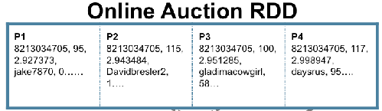

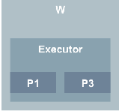
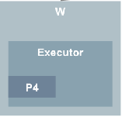
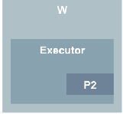
RDD Logically:

Slide 7
RDD Lazy Evaluation
Spark RDD follows lazy evaluation , that mean when you try to access the source file or source dataset then only it will check for the source availability.
Ex:
scala> val fileRDD = sc.textFile("/user/spark/sample.csv")
fileRDD: org.apache.spark.rdd.RDD[String] = /user/spark/sample.csv MapPartitionsRDD[4] at textFile at <console>:27
scala> fileRDD.count
org.apache.hadoop.mapred.InvalidInputException: Input path does not exist: hdfs://node1.hdp.com:8020/user/spark/sample.csv

Slide 8
Default Partitions in RDD
By default number of partitions = number of cores on the driver node
spark-shell --master local
val a = sc.parallelize(1 to 10000000)
a.partitions.length
res0: Int = 1 //default 1
spark-shell --master local[*]
val a = sc.parallelize(1 to 10000000)
a.partitions.length
res0: Int = 4
spark-shell --master local[6]
val a = sc.parallelize(1 to 10000000)
a.partitions.length
res0: Int = 6

Slide 9
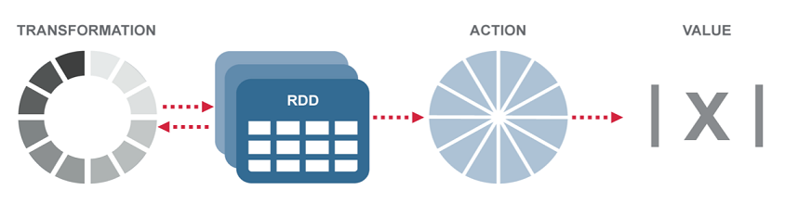
Operations On RDD’s
There are two types of data operations you can perform on an RDD,
transformations and actions.
• A transformation will return an RDD. Since RDD are immutable,
The transformation will return a new RDD.
• An action will return a value

Slide 10
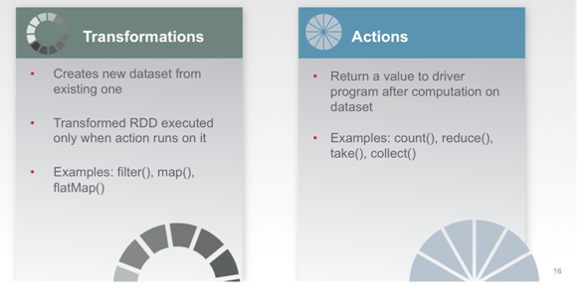
Operations On RDD’s

Slide 11
RDD Transformations
Transformations are lazy operations on a RDD that create one or many new RDDs,
RDD transformations returns pointer to new RDD and allows you to create dependencies between RDDs. Each RDD in dependency chain (String of Dependencies) has a function for calculating its data and has a pointer (dependency) to its parent RDD.
Spark is lazy, so nothing will be executed unless you call some transformation or action that will trigger job creation and execution.
Therefore, RDD transformation is not a set of data but is a step in a program (might be the only step) telling Spark how to get data and what to do with it.

Slide 12
RDD Transformations
Given below is a list of RDD Transformations
map
flatMap
filter
mapPartitions
mapPartitionsWithIndex
sample
union
intersection
distinct
groupBy
keyBy
Zip
zipwithIndex
Colease
Repartition
sortBy

Slide 13
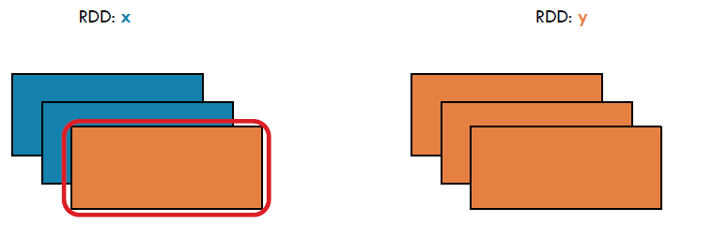
RDD Transformations (map[func])
Pass each element through function
Ex:
scala> val x = sc.parallelize(List("spark", "rdd", "example", "sample", "example"), 3)
scala> val y = x.map(x => (x, 1))
scala> y.collect
res0: Array[(String, Int)] = Array((spark,1), (rdd,1), (example,1), (sample,1), (example,1))
// rdd y can be re writen with shorter syntax in scala as
scala> val y = x.map((_, 1))
scala> y.collect
res0: Array[(String, Int)] = Array((spark,1), (rdd,1), (example,1), (sample,1), (example,1))

Slide 14
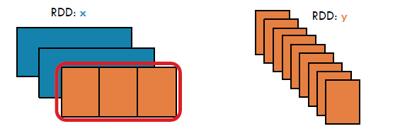
RDD Transformations (flatMap[func])
“Similar to map, but each input item can be mapped to 0 or more output items (so func should return a Seq rather than a single item).”
Ex:
scala>sc.parallelize(List(1,2,3)).flatMap(x=>List(x,x,x)).collect
res200: Array[Int] = Array(1, 1, 1, 2, 2, 2, 3, 3, 3)
scala>sc.parallelize(List(1,2,3)).map(x=>List(x,x,x)).collect
res201: Array[List[Int]] = Array(List(1, 1, 1), List(2, 2, 2), List(3, 3, 3))

Slide 15
RDD Transformations : (map vs flatMap)
This is test input
I think another line
RDD of text File
val data = sc.textFile(“text.txt”)
wordsRDD = data.map(line => line.split(“ ”))
//Map converts each line into to a array of string.
Array[Array[String]] = Array[Array[This,is,test,input],Array[I,think,another,line]]
val wordsRDD = data.flatMap(line => line.split(“ ”))
wordsRDD becomes
Array[String] = Array[This,is, a , test,input,I,think,another,line]

Slide 16
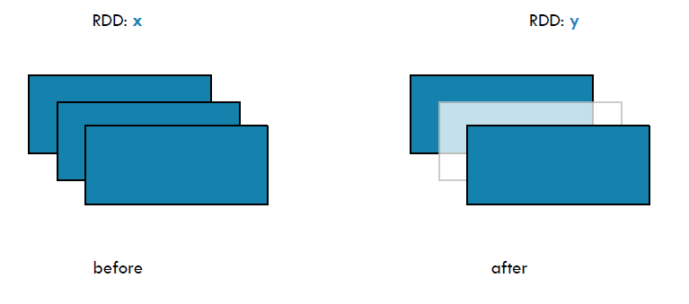
RDD Transformations : filter(func)
Similar to map, but each input item can be mapped to 0 or more output items (so func should return a Seq rather than a single item)..
Ex:
scala> val numbers = sc.parallelize(List(1,2,3,4,5,6,7,8,9,10))
numbers: org.apache.spark.rdd.RDD[Int] = ParallelCollectionRDD[5] at parallelize at <console>:27
scala> val evens = numbers.filter(_%2==0).collect
evens: Array[Int] = Array(2, 4, 6, 8, 10)

Slide 17
RDD Transformations : sample(withReplacement,fraction,seed)
Sample a fraction fraction of the data, with or without replacement, using a given random number generator seed.
withReplacement - can elements be sampled multiple times (replaced when sampled out)
fraction - expected size of the sample as a fraction of this RDD's size without replacement: probability that each element is chosen; fraction must be [0, 1] with replacement: expected number of times each element is chosen; fraction must be >= 0
seed - seed for the random number generator

Slide 18
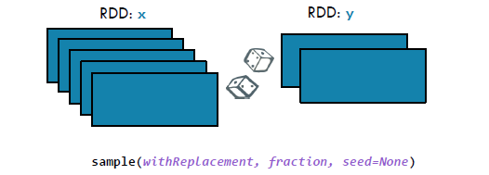
RDD Transformations : sample(withReplacement,fraction,seed)
Ex:
val parallel = sc.parallelize(1 to 9)
parallel.sample(true,.2).count
parallel.sample(false,.2).collect
parallel.sample(true,.2).count
parallel.sample(false,1).collect
Array[Int] = Array(1, 2, 3, 4, 5, 6, 7, 8, 9)

Slide 19
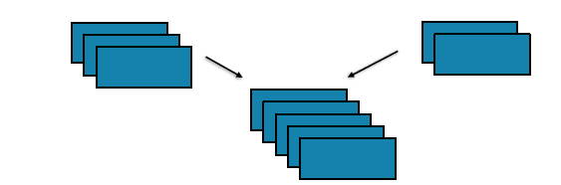
RDD Transformations : union(a different rdd)
Simple. Return the union of two RDDs
Ex:-
scala>val parallel = sc.parallelize(1 to 9)
scala>val par2 = sc.parallelize(5 to 15)
scala>parallel.union(par2).collect
res408: Array[Int] = Array(1, 2, 3, 4, 5, 6, 7, 8, 9, 5, 6, 7, 8, 9, 10, 11, 12, 13, 14, 15)

Slide 20
RDD Transformations : intersection(a different rdd)
Similar to union but return the intersection of two RDDs
Ex:
scala>val parallel = sc.parallelize(1 to 9)
parallel: org.apache.spark.rdd.RDD[Int] = ParallelCollectionRDD[477] at parallelize at <console>:12
scala>val par2 = sc.parallelize(5 to 15)
par2: org.apache.spark.rdd.RDD[Int] = ParallelCollectionRDD[478] at parallelize at <console>:12
scala>parallel.intersection(par2).collect
res409: Array[Int] = Array(8, 9, 5, 6, 7)

Slide 21
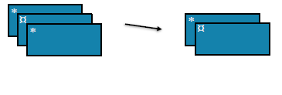
RDD Transformations : distinct([numTasks])
Another simple one. Return a new RDD with distinct elements within a source
Ex:
scala>val parallel = sc.parallelize(1 to 9)
scala>val par2 = sc.parallelize(5 to 15)
scala>parallel.union(par2).distinct.collect
res412: Array[Int] = Array(1, 2, 3, 4, 5, 6, 7, 8, 9, 10, 11, 12, 13, 14, 15)

Slide 22
RDD Transformations : sortBy(func)
Return this RDD sorted by the given key function
Ex:
scala> val y = sc.parallelize(Array(5, 7, 1, 3, 2, 1))
y: org.apache.spark.rdd.RDD[Int] = ParallelCollectionRDD[5] at parallelize at <console>:27
scala> y.sortBy(c => c, true).collect
res4: Array[Int] = Array(1, 1, 2, 3, 5, 7)
scala> val z = sc.parallelize(Array(("H", 10), ("A", 26), ("Z", 1), ("L", 5)))
z: org.apache.spark.rdd.RDD[(String, Int)] = ParallelCollectionRDD[11] at parallelize at <console>:27
scala> z.sortBy(c => c._2, false).collect
res5: Array[(String, Int)] = Array((A,26), (H,10), (L,5), (Z,1))

Slide 23
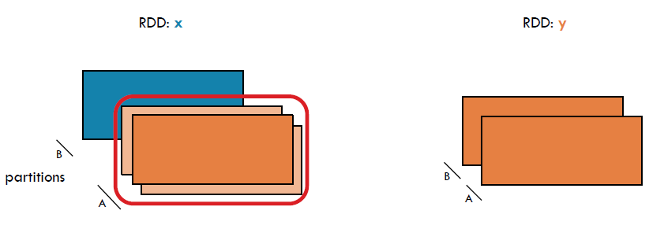
RDD Transformations : mapPartitions(func)
mapPartitions() can be used as an alternative to map() & foreach().mapPartitions() is called once for each Partition unlike map() & foreach() which is called for each element in the RDD. .
Ex:
scala> var parellal = sc.parallelize(1 to 9, 3)
parellal.mapPartitions(x=>List(x.next).iterator).collect
res2: Array[Int] = Array(1, 4, 7)
scala> var parellal = sc.parallelize(1 to 9)
parellal.mapPartitions(x=>List(x.next).iterator).collect
res2: Array[Int] = Array(1, 2, 3, 4, 5, 6, 7, 8 ,9)

Slide 24
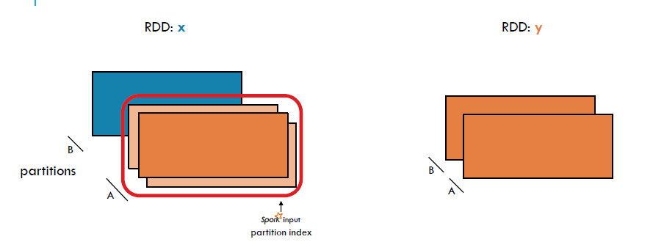
RDD Transformations : mapPartitionsWithIndex
Return a new RDD by applying a function to each partition of this RDD, while tracking the index of the original partition.

Slide 25
RDD Transformations : mapPartitionsWithIndex
Ex:
scala> val nums = sc.parallelize(List(1,2,3,4,5,6), 2)
nums: org.apache.spark.rdd.RDD[Int] = ParallelCollectionRDD[17] at parallelize at <console>:27
scala> def myfunc(index: Int, iter: Iterator[(Int)]) : Iterator[String] = {
| iter.toList.map(x => "[index:" + index + ", val: " + x + "]").iterator
| }
myfunc: (index: Int, iter: Iterator[Int])Iterator[String]
scala> nums.mapPartitionsWithIndex(myfunc).collect
res6: Array[String] = Array([index:0, val: 1], [index:0, val: 2], [index:0, val: 3], [index:1, val: 4], [index:1, val: 5], [index:1, val: 6])

Slide 26
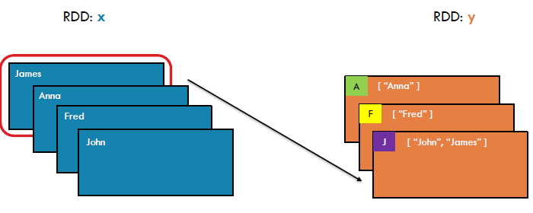
RDD Transformations : groupBy
Return a new RDD by grouping the objects in existed RDD using given grouping key,
Val x= sc.parallelize(
Array("John", "Fred", "Anna", "James"))
Val y= x.groupBy(w => w.charAt(0))
println(y.collect().mkString(", "))

Slide 27
RDD Transformations : groupBy
Ex:2
scala> val rdd = sc.parallelize(List((1,"apple"),(2,"banana"),(3,"lemon"),(4,"apple"),(1,"lemon")) )
rdd: org.apache.spark.rdd.RDD[(Int, String)] = ParallelCollectionRDD[0] at parallelize at <console>:27
scala> rdd.groupBy(_._1).collect
res8: Array[(Int, Iterable[(Int, String)])] = Array((4,CompactBuffer((4,apple))), (2,CompactBuffer((2,banana))), (1,CompactBuffer((1,apple), (1,lemon))), (3,CompactBuffer((3,lemon))))

Slide 28
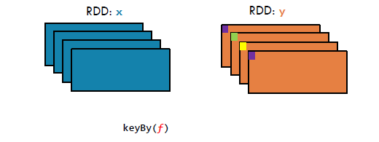
RDD Transformations : keyBy
Return a new RDD by changing the key of the RDD element using the given key object.
val x= sc.parallelize(
Array("John", "Fred", "Anna", "James"))
Val y= x.keyBy(w => w.charAt(0))
println(y.collect().mkString(", "))

Slide 29
RDD Transformations : keyBy
Ex:
scala> val rdd = sc.parallelize(List((1,"apple"),(2,"banana"),(3,"lemon"),(4,"apple"),(1,"lemon")) )
rdd: org.apache.spark.rdd.RDD[(Int, String)] = ParallelCollectionRDD[0] at parallelize at <console>:27
scala> rdd.keyBy(_._1).collect
res10: Array[(Int, (Int, String))] = Array((1,(1,apple)), (2,(2,banana)), (3,(3,lemon)), (4,(4,apple)), (1,(1,lemon)))
scala> rdd.keyBy(_._2).collect
res11: Array[(String, (Int, String))] = Array((apple,(1,apple)), (banana,(2,banana)), (lemon,(3,lemon)), (apple,(4,apple)), (lemon,(1,lemon)))

Slide 30
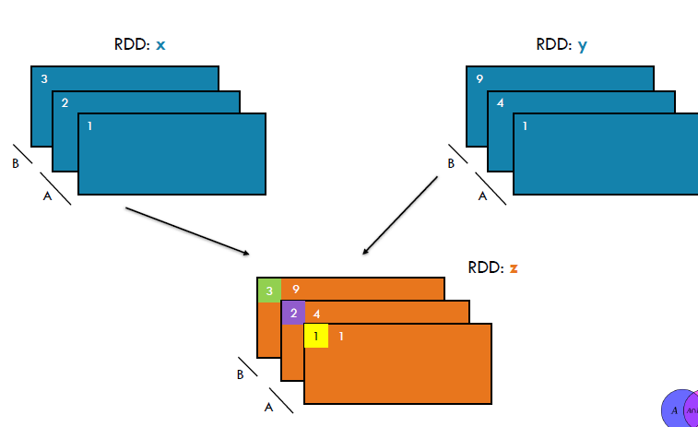
RDD Transformations : zip
Returns a RDD formed from this list and another iterable collection by combining
corresponding elements in pairs. If one of the two collections is longer than the
other, its remaining elements are ignored.

Slide 31
RDD Transformations : zip
Ex:
scala> val odds = sc.parallelize(List(1,3,5))
odds: org.apache.spark.rdd.RDD[Int] = ParallelCollectionRDD[17] at parallelize at <console>:27
scala> val evens = sc.parallelize(List(2,4,6))
evens: org.apache.spark.rdd.RDD[Int] = ParallelCollectionRDD[18] at parallelize at <console>:27
scala> val numbers = odds zip evens
numbers: org.apache.spark.rdd.RDD[(Int, Int)] = ZippedPartitionsRDD2[19] at zip at <console>:31
scala> numbers.collect
res12: Array[(Int, Int)] = Array((1,2), (3,4), (5,6))

Slide 32
RDD Transformations : zipWithIndex
Returns a new RDD containing pairs consisting of all elements of this list
paired with their index. Indices start at 0.
Ex:
scala> val evens = sc.parallelize(List(2,4,6))
evens: org.apache.spark.rdd.RDD[Int] = ParallelCollectionRDD[18] at parallelize at <console>:27
scala> val evenswithIndex = evens zipWithIndex
evenswithIndex: org.apache.spark.rdd.RDD[(Int, Long)] = ZippedWithIndexRDD[20] at zipWithIndex at <console>:29
scala> evenswithIndex.collect
res13: Array[(Int, Long)] = Array((2,0), (4,1), (6,2))

Slide 33
RDD Transformations : zipWithIndex
Returns a new RDD containing pairs consisting of all elements of this list
paired with their index. Indices start at 0.
Ex:
scala> val evens = sc.parallelize(List(2,4,6))
evens: org.apache.spark.rdd.RDD[Int] = ParallelCollectionRDD[18] at parallelize at <console>:27
scala> val evenswithIndex = evens zipWithIndex
evenswithIndex: org.apache.spark.rdd.RDD[(Int, Long)] = ZippedWithIndexRDD[20] at zipWithIndex at <console>:29
scala> evenswithIndex.collect
res13: Array[(Int, Long)] = Array((2,0), (4,1), (6,2))

Slide 34
RDD Transformations : zipWithIndex
Returns a new RDD containing pairs consisting of all elements of this list
paired with their index. Indices start at 0.
Ex:
scala> val evens = sc.parallelize(List(2,4,6))
evens: org.apache.spark.rdd.RDD[Int] = ParallelCollectionRDD[18] at parallelize at <console>:27
scala> val evenswithIndex = evens zipWithIndex
evenswithIndex: org.apache.spark.rdd.RDD[(Int, Long)] = ZippedWithIndexRDD[20] at zipWithIndex at <console>:29
scala> evenswithIndex.collect
res13: Array[(Int, Long)] = Array((2,0), (4,1), (6,2))

Slide 35
RDD Transformations : repartition
The repartition method can be used to either increase or decrease the number of partitions in a RDD.
The repartition algorithm does a full shuffle and creates new partitions with data that's distributed evenly.
Ex:
scala> val numbers = sc.parallelize( 1 to 100,2)
numbers: org.apache.spark.rdd.RDD[Int] = ParallelCollectionRDD[4] at parallelize at <console>:27
scala> numbers.partitions.size
res4: Int = 2
scala> val numberIncreased = numbers.repartition(10)
numberIncreased: org.apache.spark.rdd.RDD[Int] = MapPartitionsRDD[9] at repartition at <console>:29
scala> numberIncreased.partitions.size
res7: Int = 10
scala> numbers.repartition(1)
res15: org.apache.spark.rdd.RDD[Int] = MapPartitionsRDD[14] at repartition at <console>:30
scala> res15.partitions.size
res18: Int = 1

Slide 36
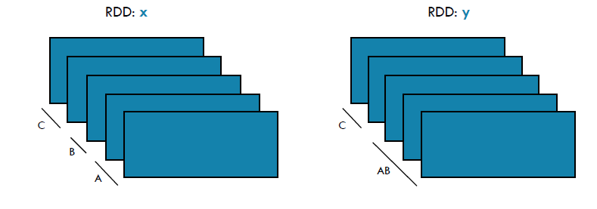
RDD Transformations : colease
This method is used to reduce the number of partitions in the RDD.
x:
scala> val numbers = sc.parallelize( 1 to 100,2)
scala> numberIncreased.coalesce(3)
scala> res11.foreachPartition(x => println(x.toList))

Slide 37
Colease vs Repartition:
Colease | Repartition
coalesce uses existing partitions to minimize the amount of data that's shuffled. | repartitioncreates new partitions and does a full shuffle.
coalesce results in partitions with different amounts of data (sometimes partitions that have much different sizes) | repartition results in roughly equal sized partitions.
Faster | Not faster than colease

Slide 38
RDD Actions :
Unlike Transformations which produce RDDs, action functions produce a value back to the Spark driver program. Actions may trigger a previously constructed, lazy RDD to be evaluated.
Commonly Used Actions :
reduce(func)
first
takeOrdered
take
count
collect
collectasMap
saveAsTextFile
foreachPartition
Foreach
Max
Min
Sum
Mean
Variance
stdev

Slide 39
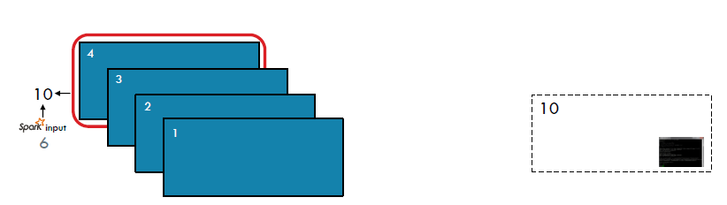
RDD Actions : reduce[func]
Aggregate the elements of a dataset through fu
Ex:
val a = sc.parallelize(1 to 10, 3)
a.reduce(_ + _)
res: Int = 55
scala>val names1 = sc.parallelize(List("abe", "abby", "apple"))
scala> names1.flatMap(k => List(k.size) ).reduce((t1,t2) => t1 + t2)
res779: Int = 12
scala> names1.reduce((t1,t2) => t1 + t2)
res778: String = abbyabeapple

Slide 40
RDD Actions : first()
Return the first element in the RDD
Ex:
scala>val names2 = sc.parallelize(List("apple", "beatty", "beatrice"))
names2: org.apache.spark.rdd.RDD[String] = ParallelCollectionRDD[1477] at parallelize at <console>:12
scala> names2.first
res785: String = apple

Slide 41
RDD Actions : takeOrdered(num)
It will return a Array with given numbers of ordered values in the RDD
Ex:
scala> val nums = sc.parallelize(List(1,5,3,9,4,0,2))
nums: org.apache.spark.rdd.RDD[Int] = ParallelCollectionRDD[9] at parallelize at <console>:30
scala> nums.takeOrdered(4)
res19: Array[Int] = Array(0, 1, 2, 3)

Slide 42
RDD Actions : take(num)
It will return a Array with first given numbers of values in the RDD
Ex:
scala> val nums = sc.parallelize(List(1,5,3,9,4,0,2))
nums: org.apache.spark.rdd.RDD[Int] = ParallelCollectionRDD[9] at parallelize at <console>:30
scala> nums.take(4)
res20: Array[Int] = Array(1, 5, 3, 9)

Slide 43
RDD Actions : count
It will return a Long value that indicates how many elements presented in the RDD.
Ex:
scala> val nums = sc.parallelize(List(1,5,3,9,4,0,2))
nums: org.apache.spark.rdd.RDD[Int] = ParallelCollectionRDD[9] at parallelize at <console>:30
scala> nums.count
res21: Long = 7

Slide 44
RDD Actions : collect(func)
collect returns the elements of the dataset as an array back to the driver program
Ex:
val c = sc.parallelize(List("Gnu", "Cat", "Rat", "Dog", "Gnu", "Rat"), 2)
c.collect
res35: Array[String] = Array(Gnu, Cat, Rat, Dog, Gnu, Rat)
val c = sc.parallelize(List("Gnu", "Cat", "Rat", "Dog", "Gnu", "Rat"), 2)
c.distinct.collect
res: Array[String] = Array(Dog, Gnu, Cat, Rat)

Slide 45
CollectAsMap
It will return A Map object containg all key value pairs converted as Map.
Ex:
scala> val alphanumerics = sc.parallelize(List((1,"a"),(2,"b"),(3,"c")))
alphanumerics: org.apache.spark.rdd.RDD[(Int, String)] = ParallelCollectionRDD[11] at parallelize at <console>:30
scala> alphanumerics.collectAsMap
res22: scala.collection.Map[Int,String] = Map(2 -> b, 1 -> a, 3 -> c)

Slide 46
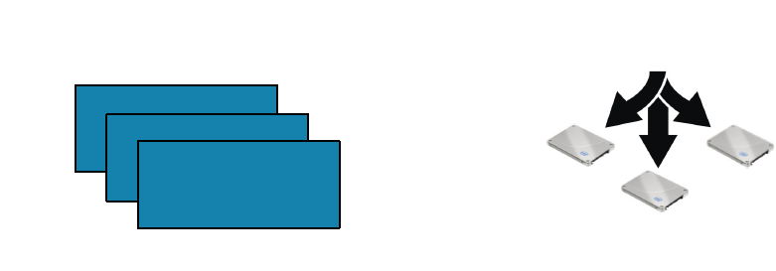
RDD Actions : saveAsTextFile(filepath)
Write out the elements of the data set as a text file in a filepath directory on the filesystem, HDFS or any other Hadoop-supported file system.
Ex:
val a = sc.parallelize(1 to 10000, 3)
a.saveAsTextFile("mydata_a")
val x = sc.parallelize(List(1,2,3,4,5,6,6,7,9,8,10,21), 3)
x.saveAsTextFile("hdfs://localhost:8020/user/hadoop/test");

Slide 47
RDD Actions : foreachPartition
Executes an parameterless function for each partition. Access to the data items contained in the partition is provided via the iterator argument
Ex:
val b = sc.parallelize(List(1, 2, 3, 4, 5, 6, 7, 8, 9), 3)
b.foreachPartition(x => println(x.reduce(_ + _)))
6
15
24

Slide 48
foreach
It will pass each element in the RDD for given function .
EX:
scala> val alphanumerics = sc.parallelize(List((1,"a"),(2,"b"),(3,"c")))
alphanumerics: org.apache.spark.rdd.RDD[(Int, String)] = ParallelCollectionRDD[15] at parallelize at <console>:27
scala> alphanumerics.foreach(println)
(2,b)
(1,a)
(3,c)

Slide 49
Max,Min,Sum,Mean,Variance,stdev
Spark RDD supports some Mathametical Actions like below.
Ex:
scala> val numbers = sc.parallelize(1 to 100)
numbers: org.apache.spark.rdd.RDD[Int] = ParallelCollectionRDD[16] at parallelize at <console>:27
scala> numbers.sum scala> numbers.max
res21: Double = 5050.0 res22: Int = 100
scala> numbers.min scala> numbers.mean
res23: Int = 1 res24: Double = 50.5
scala> numbers.variance scala> numbers.stdev
res25: Double = 833.25 res26: Double = 28.86607004772212

Slide 50
Summary
RDD is a collection of elements partitioned across the nodes of the cluster that can be operated on in parallel.
RDDs are created by starting with a file in the Hadoop file system (or any other Hadoop-supported file system), or an existing Scala collection in the driver program, and transforming it.
RDDs are immutable in nature.
this lazy evaluation decreases the overhead of computation and make the system more efficient.

Slide 51
QUIZ
What is RDD
How do we calculate Default number of partitions in an RDD
When we apply Action on an RDD , it will generate one more RDD.(T/F)
Which Action we use to save the RDD as a file in HDFS
Which function we use to Aggregate the elements of a dataset through function.
Which function is used to Return a new RDD by applying a function to each partition of this RDD, while tracking the index of the original partition.

Slide 52
MCQ
Q.1 FlatMap transforms an RDD of length N into another RDD of length M. Which of the following is true for N and M?
N>M
N
N<=M
Either a or b
Either b or c
Q.2 Fault Tolerance in RDD is achieved using
Immutable nature of RDD
DAG(Directed Acyclic Graph)
lazy-evaluation
none of these
Q.3 "What will be the output:
val rawData = spark.read.textFile("PATH").rdd
val result = rawData.filter…"
Process the data as per the specified logic
Compilation error
Won't be executed
None

Slide 53
MCQ
Q.4 RDD is
Immutable
Recomputable
Fault-tolerant
All of the above
Q.5 Choose correct statement
All the transformations and actions are lazily evaluated
Execution starts with the call of Action
Execution starts with the call of Transformation
None

Slide 54
Hansdon
https://drive.google.com/drive/u/0/folders/1LE-SmYCNextoAM8VFTzKXRribFyby6iM

Slide 55
Thank You…….
Any Queries…..

